Slide 1
2016 Danube Water Conference

Slide 2
External governance: An example of private sector participation
Introduction
Overview of the utility
Keys to success
Conclusions

Slide 3
1. Introduction

Slide 4
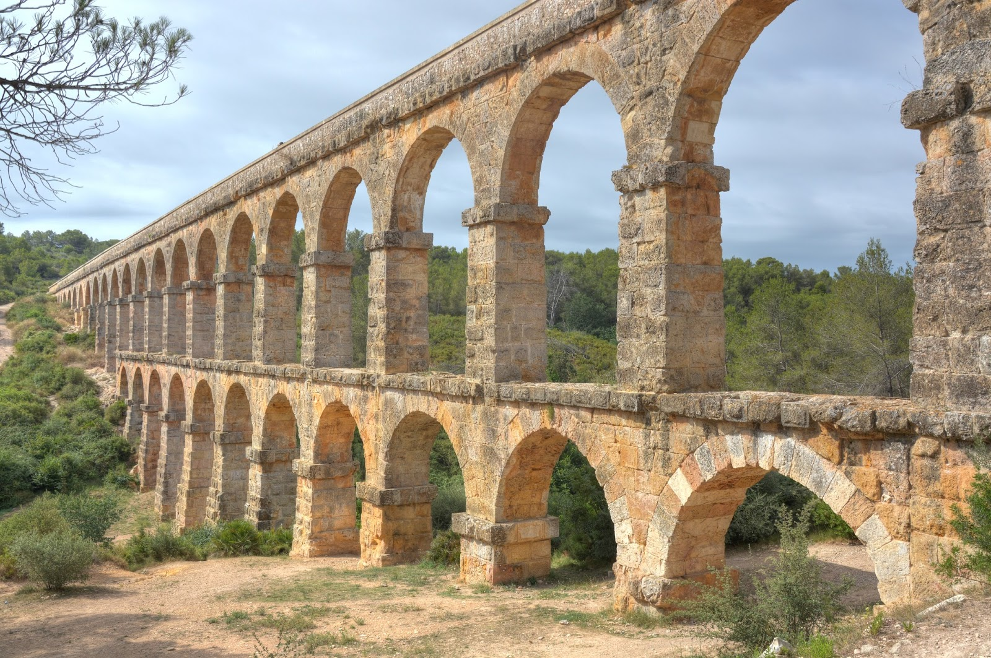
Where are we ?
TARRAGONA

Slide 5
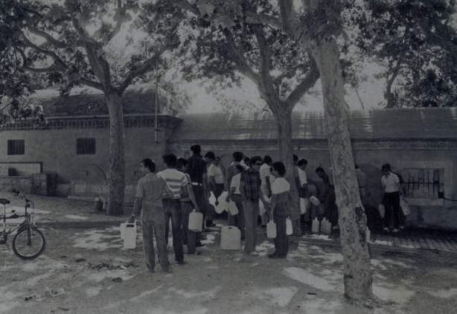
Background
70’s: scarce and salinized resources
1983: mixed capital company

Slide 6
Legal status and ownership
1 President
1 Vice-president
3 Board members
1 CEO
3 Board members
Spanish Private Corporation Law and the regulation of public services.

Slide 7
ORGANIZATION CHART
SHAREHOLDERS MEETING
(President and CEO)
SUPERVISORY BOARD
(President, CEO, vice-president and 6 board members)
MANAGEMENT BOARD
(General Manager and Deputy Manager)
Heads of Departments and Units

Slide 8
2. Overview of the utility

Slide 9
GENERAL AND ECONOMIC MAIN FIGURES
Population served 150.000 inhab.
Water used per person and day 113 L.
Number of employees 120
Outsourced contracts/operational budget 29 %
2015 turnover 22.5 M€.
Average municipal fee 1.71 €/m³ tap water 0.32 €/m³ sewerage
Average regional canon 0.69 €/m³

Slide 10
QUALITY OF SERVICE
Quality Management ISO 9001
Health and Safety Protection OHSAS 18001
Water Safety Management (HACCP) ISO 22000
Environmental Management ISO 14001
Testing laboratories ISO 17025
Energy management ISO 50001
Corporate Social Responsibility reporting

Slide 11
EFFICIENCY
Unaccounted for water 19 %
Smart metering 21 %
Annual network breakdowns and leaks / km 0.82
Efficiency in wastewater treatment 96.4 % (BOD)
Water supply and sanitation coverage 100 %
Staff per 1.000 population served 0.8

Slide 12
3. keys to success

Slide 13
EXTERNAL AUTONOMY
TARIFFS
UTILITY
CITY COUNCIL
The water service is of common interest and unites all political visions
The City Council:
acts as an owner ensuring our financial sustainability
considers the water infrastructure as a crucial asset of the city
keeps the main strategic lines with gentle political consensus
COMPANY’S AUTONOMY

Slide 14
CORPORATE CULTURE
The alliance with AGBAR implies:
innovation oriented culture
team work and individual performance
technological surveillance
excellence and continuous improvement
This know-how and knowledge transfer keeps our training needs updated
The AGBAR culture provides us with agility in the decision making process

Slide 15
4. Conclusions

Slide 16
MAIN CONCLUSION
Long-term vision and mutual confidence
right balance between the spirit of public service and the commitment with lean managing and innovation

Slide 17
E
m
a
t
s
a
LOOKING AH AD
EMATSA’s challenge fro now on is
to maint in our performing standards
through Corpora e Social Responsibility
and as uring management efficiency
in order to gu rantee its sustainability

Slide 18
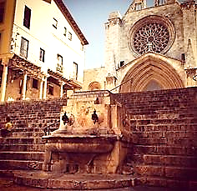
Thank you very much
dmilan@ematsa.cat
www.ematsa.cat
@ematsa

